Slide 1
Topic 3: variables and types

Slide 2
3.1 DATA TYPES
• Numeric: int, float, complex
• String: str
• Sequence: list, tuple, range
• Binary: bytes, bytearray, memoryview
• Mapping: dict
• Boolean: bool
• Set: set, frozenset

Slide 3
Numeric: These data types are used to store numbers. The int data type stores whole numbers, the float data type stores floating-point numbers, and the complex data type stores complex numbers
String: This data type is used to store text. Strings are enclosed in single or double quotes.
Sequence: These data types store collections of objects. The list data type is a mutable sequence, which means that its elements can be changed. The tuple data type is an immutable sequence, which means that its elements cannot be changed. The range data type is a sequence of numbers that starts at a specified value and increments by a specified amount

Slide 4
Binary: These data types are used to store binary data. The bytes data type stores a sequence of bytes, the bytearray data type stores a mutable sequence of bytes, and the memoryview data type stores a view of a memory buffer.
Mapping: This data type is used to store key-value pairs. The dict data type is a mutable mapping, which means that its key-value pairs can be changed.
Boolean: This data type stores a value of either True or False.
Set: This data type stores a collection of unique elements. The set data type is a mutable set, which means that its elements can be changed. The frozenset data type is an immutable set, which means that its elements cannot be changed.

Slide 5
Sequence Types:
name = "John"
print(name) # Output: John
numbers = [1, 2, 3, 4, 5]
print(numbers) # Output: [1, 2, 3, 4, 5]
coordinates = (10, 20)
print(coordinates) # Output: (10, 20)
#age = 25
print(age) # Output: 25
# float
pi = 3.14
print(pi) # Output: 3.14
c = 3 + 2j
print(c) # Output: (3+2j)
Mapping Type:
dict: Represents a collection of key-value pairs.
person = {'name': 'John', 'age': 30, 'city': 'New York'}
print(person) # Output: {'name': 'John', 'age': 30, 'city': 'New York'}

Slide 6
Boolean Type:
bool: Represents a boolean value (True or False).
is_valid = True
print(is_valid) # Output: True
None Type:
None: Represents the absence of a value or null.
result = None
print(result) # Output: None
Set Types:
set: Represents an unordered collection of unique elements.
numbers = {1, 2, 3, 4, 5}
print(numbers) # Output: {1, 2, 3, 4, 5}
frozenset: Represents an immutable set.
vowels = frozenset({'a', 'e', 'i', 'o', 'u'})
print(vowels) # Output: frozenset({'a', 'e', 'i', 'o', 'u'})

Slide 7
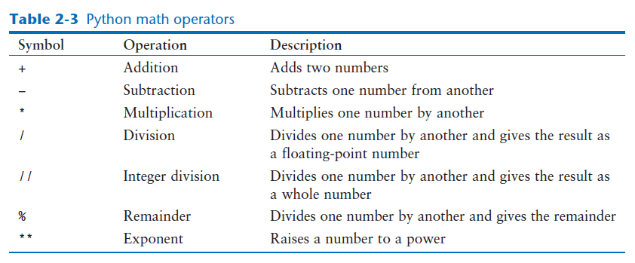
3.2 Python math library

Slide 8
Program 2-14 (simple_math.py)
1 # Assign a value to the salary variable.
2 salary = 2500.0
3
4 # Assign a value to the bonus variable.
5 bonus = 1200.0
6
7 # Calculate the total pay by adding salary
8 # and bonus. Assign the result to pay.
9 pay = salary + bonus
10
11 # Display the pay.
12 print('Your pay is', pay)
Program Output
Your pay is 3700.0

Slide 9
Calculating a percentage
Program 2-15 (sale_price.py)
1 # This program gets an item's original price and
2 # calculates its sale price, with a 20% discount.
4 # Get the item's original price.
5 original_price = float(input("Enter the item's original price: "))
6
7 # Calculate the amount of the discount.
8 discount = original_price * 0.2
9
10 # Calculate the sale price.
11 sale_price = original_price − discount
12
13 # Display the sale price.
14 print('The sale price is', sale_price)
Program Output (with input shown in bold)
Enter the item's original price: 100.00
The sale price is 80.0

Slide 10
Floating-Point and Integer Division
The / operator performs floating-point division, and the // operator performs integer division. Both operators divide one number by another. The difference between them is that the / operator gives the result as a floating-point value, and the // operator gives the result as a whole number.
Let’s use the interactive mode interpreter to demonstrate:
>>> 5 / 2 Enter
2.5
In this session, we used the / operator to divide 5 by 2. As expected, the result is 2.5. Now
Let’s use the // operator to perform integer division:
>>> 5 // 2 Enter
2
5 + 2 * 4 13
10 / 2 − 3 2.0
8 + 12 * 2 − 4 28
6 − 3 * 2 + 7 − 16

Slide 11
Program 2-16 (test_score_average.py)
1 # Get three test scores and assign them to the
2 # test1, test2, and test3 variables.
3 test1 = float(input('Enter the first test score: '))
4 test2 = float(input('Enter the second test score: '))
5 test3 = float(input('Enter the third test score: '))
6
7 # Calculate the average of the three scores
8 # and assign the result to the average variable.
9 average = (test1 + test2 + test3) / 3.0
10
11 # Display the average.
12 print('The average score is', average)
Program Output (with input shown in bold)
Enter the first test score: 90 Enter
Enter the second test score: 80
Enter the third test score: 100
The average score is 90.0

